Slide 1
Treatment outcomes with bedaquiline use when substituted for second-line injectables in multidrug resistant tuberculosis: a retrospective cohort study
24 July 2018
Ying Zhao, Tamaryn Fox, Kathryn Manning, Annemie Stewart, Nicki Tiffin, Andrew Boulle, Vanessa Mudaly, Yulene Kock, Graeme Meintjes and Sean Wasserman

Slide 2
Disclosure
We have no conflicts of interests to declare for this study.

Slide 3
Background/rationale
Injectables cause substantial toxicity and require frequent treatment interruption → outcomes may be worse
Bedaquiline improves culture conversion rates when added to conventional MDR-TB treatment
Safety concerns
QT interval prolongation: median 15 msec
Increased mortality: 10 versus 2 deaths (P=0.02)
Used as a substitute if unable to tolerate injectables, but the efficacy and safety of this strategy is unknown
Shean, PloS ONE 2013
Diacon, N Engl J Med 2014
Guglielmetti, Int J Tuberc Lung Dis 2017

Slide 4
Aims
Evaluate treatment outcomes for MDR-TB patients substituting bedaquiline for injectables at 12 months after MDR-TB treatment initiation in Western Cape Province of South Africa, compared to those continuing injectable therapy.

Slide 5
Study population
Local clinicians make requests for bedaquiline access to a Provincial Clinical Advisory Committee using a standardized application form.
If approved, bedaquiline is provided for a minimum of 24 weeks.
From December 2012, bedaquiline was made available to South African patients with XDR-TB and pre-XDR-TB.
In September 2015, bedaquiline access was decentralized to include adults with MDR-TB unable to tolerate injectables.

Slide 6
Study design
Retrospective cohort study
Cases
Controls
Consecutive adults with MDR-TB receiving bedaquiline as a substitute for injectables in the Western Cape Province, between October 2014 and October 2016
Adults with MDR-TB receiving standard therapy, matched 1:1 for clinic location and time of treatment initiation within a +/- 6-month window

Slide 7
Outcome measures
Primary: unfavourable outcome at 12 months
Composite of death, loss to follow up, or treatment failure
Treatment failure
Failure to achieve sustained culture conversion at 12 months
Sustained culture conversion:
≥ 2 consecutive negative cultures with the last culture performed at 12 months (+/- 2 months)

Slide 8
Study population
Cases
Controls
162 patients
168 patients
17 missing vital status at 12 months
43 (27%) missing follow up culture results
21 missing vital status at 12 months
59 (35%) missing follow up culture results
146 (90%) patients evaluated for primary endpoint
141 (84%) patients evaluated for primary endpoint

Slide 9
Sources of data
51 treatment facilities
Electronic TB register
Central laboratory data warehouse
Electronic prescribing records

Slide 10
Baseline Demographic and Clinical Characteristics
Variable | Bedaquiline (N = 162) | Control (N = 168)
Age | 42 (35-49) | 35 (28-42)
Male sex | 93 (57.4) | 97 (58.1)
HIV-infection | 110 (67.9) | 94 (74.0)
CD4 count | 97 (45-201) | 205 (58.5-361.5)
On ART | 94 (85.5) | ND
Viral load < 50 copies/ml | 46 (63.0) | 50 (72.5)
Previous TB | 88 (63.3) | 95 (56.6)
Sputum culture positive | 142 (87.7) | 148 (88.1)
Sputum Xpert MTB/RIF positive | 111 (68.5) | 112 (66.7)
Sputum smear positive | 98 (60.5) | 112 (66.7)
P=0.0073

Slide 11
Timing and reasons for substitution
133 (81.4%) switched from injectable to bedaquiline
44 day (IQR 29 – 70) delay from injectable withdrawal to starting bedaquiline
Hearing loss: 115 (74%)
Renal failure: 28 (18%)
29 (18.6%) patients did not receive any injectable
Started bedaquiline at a median of 29 days (IQR 18 – 49)

Slide 12
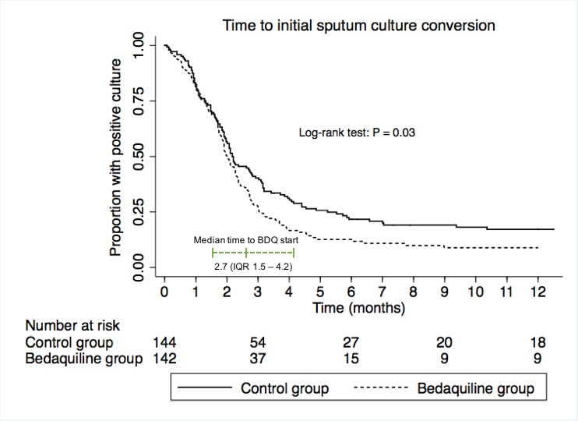
87% vs 79% culture conversion by 6 months (HR 1.32; 95% CI 1.02 – 1.71)

Slide 13
Primary composite outcome
Composite of death, loss to follow up, or failure to achieve sustained culture conversion at 12 months
Relative risk of unfavourable outcomes on bedaquiline, 0.66 (95% CI, 0.46 to 0.95)

Slide 14
Outcomes: 12 months
Variable | Bedaquiline n = 162 | Control n = 168 | P-value
Died | 11/145 (7.6) | 11/147 (7.5) | 0.973
Loss to follow up | 17/162 (10.5) | 21/168 (12.5) | 0.568
Failure to achieve sustained culture conversion | 7/119 (5.9) | 19/109 (17.4) | 0.006
In bedaquiline group, proportion of HIV-infected patients with unfavorable outcomes (20/100, 20%) was not significantly different to HIV-uninfected patients (15/46, 33%); P = 0.143

Slide 15
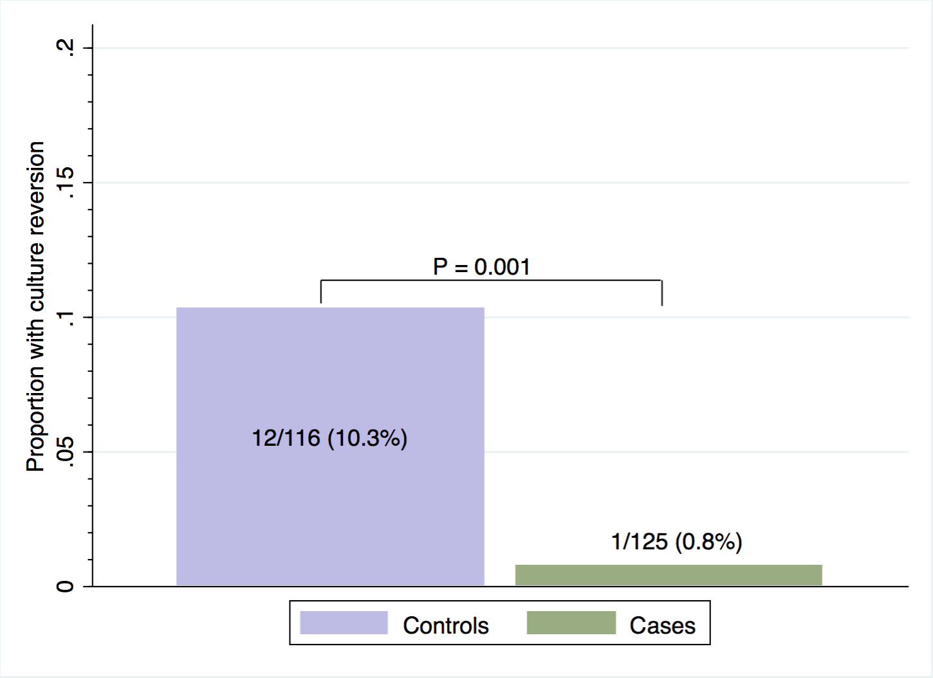
Culture reversion
Two positive sputum cultures, taken at least 30 days apart, after initial sputum culture conversion
Median 263 days (IQR 217 – 296) from the start of TB treatment

Slide 16
Conclusions
Substituting bedaquiline for injectables in MDR therapy resulted in improved outcomes after 12 months of treatment
Bedaquiline use was not associated with increased mortality
Outcomes were similar in the subgroup of HIV-infected patients receiving bedaquiline
Provides support for the use of bedaquiline in MDR-TB regimens in programmatic settings
Bedaquiline for all MDR-TB patients in South Africa since June 2018

Slide 17
Acknowledgment
Sean Wasserman
Graeme Meintjes
Staff of the Western Cape Department of Health and Data Centre
Colleagues involved in the National Bedaquiline Clinical Access Programme
Other co-authors

Slide 18
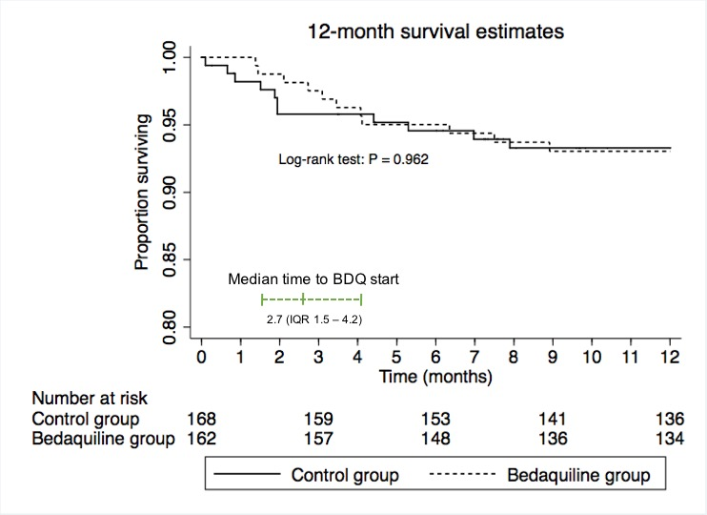

Slide 19
Table 3. Predictors of Failure to Achieve Sustained Culture Conversion At 12 Months in the Bedaquiline Group
Variable | Univariate OR (95% CI) | P-value | Multivariate OR (95% CI) | P-value
Sputum smear positive at baseline | 1.4 (0.3 – 7.8) | 0.669
Comorbid illness | 2.1 (0.5 – 10.2) | 0.336 | 1.6 (0.3 – 9.5) | 0.606
HIV infection | 0.3 (0.06 – 1.4) | 0.115 | 0.3 (0.5 – 1.7) | 0.173
Per 30-day delay from start of treatment | 1.4 (1.1 – 1.9) | 0.007 | 1.5 (1.1 – 1.9) | 0.010
Goodness-of-fit test P = 0.108 for final multivariate model (baseline smear status did not influence the effect size of the estimates in the multivariate model and was dropped to improve fit)

Slide 20
Outcomes: 18 months
Treatment Outcomes
At 18 months | Bedaquiline n = 162 | Control n = 168 | P-value
Died | 13/79 (16.5) | 15/100 (15.0) | 0.790
Failed to achieve sustained culture conversion | 3/93 (3.2) | 16/81 (19.8) | < 0.001

Slide 21
Secondary composite outcome
Death, loss to follow up, or modified definition of treatment failure (any positive sputum culture result between 6 and 12 months)
Treatment Outcomes
Variable | Bedaquiline n = 162 | Control n = 168 | P-value
Composite unfavorable outcome (secondary)# | 44/158 (27.9) | 58/152 (38.2) | 0.053
Relative risk of unfavourable outcomes in bedaquiline group, 0.73; 95% CI 0.53 to 1.0
Notes:
assessed in 287 (87%) patients

